Slide 1
Fundamentals of Database Structures and SQL Queries

Slide 2
Introduction
Structured Query Language
Specific Format
Predefined…

Slide 3
Some Reserved Word for SQL
CREATE
DROP
ALTER
RENAME
INSERT
UPDATE
DELETE
SELECT
…….

Slide 4
Types of SQL Commands
DDL(Data Definition Language)
Works on higher level like database, table
DML(Data Manipulation Language)
Works on database row level
DQL(Data Query Language)
Works on Query time

Slide 5
Types of SQL Commands Example
CREATE
DROP
ALTER
RENAME
INSERT
UPDATE
DELETE
SELECT
…….
Data Definition Language
Data Manipulation Language
Data Query Language

Slide 6
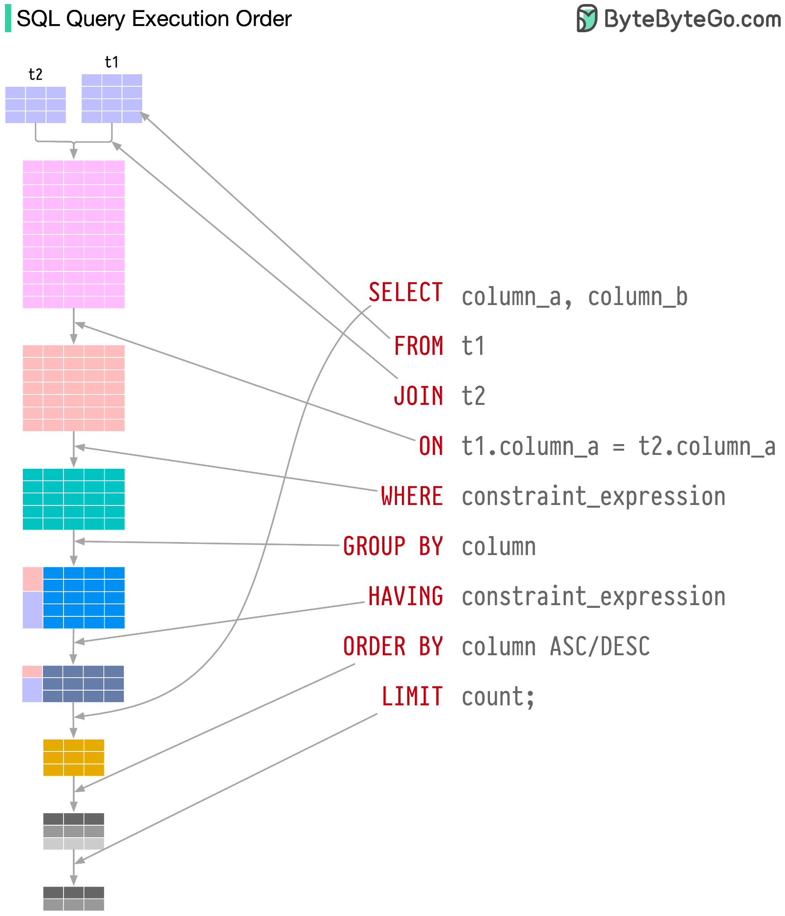

Slide 7
Group By
SELECT COUNT(CUST_ID), STATE
FROM CUSTOMER
GROUP BY STATE;

Slide 8
Group By and Having
SELECT COUNT(CUST_ID), STATE
FROM CUSTOMER
GROUP BY STATE
HAVING COUNT(CUST_ID) > 5;

Slide 9
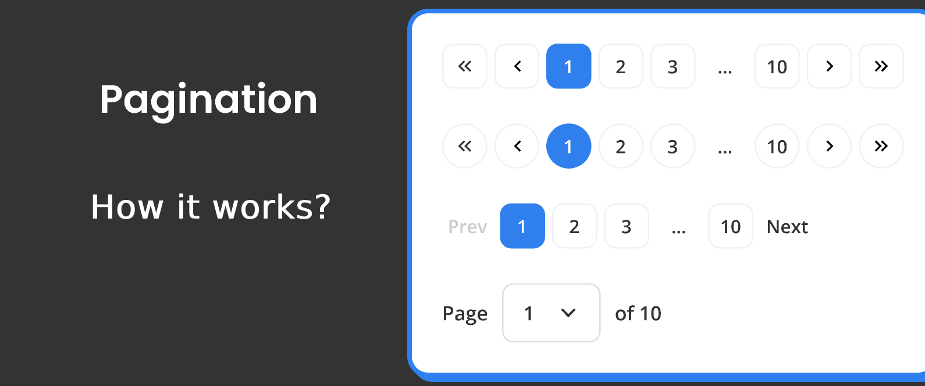
How Pagination Works?

Slide 10
Pagination Solutions
SELECT * FROM `ACCOUNT` LIMIT 5 OFFSET 10;
This will skip first 10 value then will pick next 5 value.

Slide 11
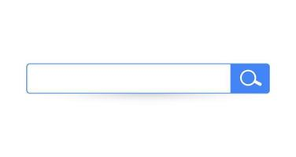
How Search Work?

Slide 12
Search Solution
SELECT * FROM `CUSTOMER` WHERE CITY LIKE '%l%'
This will find all city name containing with ‘l’
SELECT * FROM `CUSTOMER` WHERE CITY LIKE 'l%'
This will find all city name starting with ‘l’

Slide 13
Interview Question
SQL Query to Find Second Highest Salary?

Slide 14
Find the N Largest Salary
SELECT * FROM employee
WHERE salary= (SELECT DISTINCT(salary)
FROM employee ORDER BY salary DESC LIMIT 1 OFFSET N-1);
There can be multiple way for the same result

